Slide 1

Healthcare Providers and Their Impact on Overall Hospital Ratings
Jason Willis

Slide 2
Research Background
The Patient Survey – Hospital Consumer Assessment of Healthcare Providers and Systems is a dataset provided by the Centers for Medicare and Medicaid Services. (2022)
This survey posed multiple questions asked of patients and their ratings of various clinical perspectives.
What can a hospital learn from this survey? Can a hospital improve their rating, and if so, what services could they focus on?
According to Schmocker (2015) “Readiness for discharge appears to be a clinically useful patient-reported metric, as those RFD have higher satisfaction with the hospital and physicians.” Is this the only or best metric to use or can a hospital focus on provider care to strengthen their overall service ratings?

Slide 3
A - Research Question
Research Question – Is communication from a doctor more statistically significant to a patient’s overall hospital rating than a nurse?
Null Hypothesis – Doctor communication does not have a more statistically significant impact on the overall hospital rating when compared to a nurse.
Alternate Hypothesis – Doctor communication has a more statistically significant impact on the overall hospital rating when compared to a nurse.

Slide 4
B – Data Collection
The patient survey – hospital consumer assessment of healthcare providers and systems (HCAHPS) dataset (2022) posed the following questions to patients about their care. - “nurse communication”, - “doctor communication” - “overall hospital rating”. Note: A 5-star rating system was utilized. This dataset provided ratings for 4,000+ clinics; over 450,000 rows of data, for the questions above for over.

Slide 5
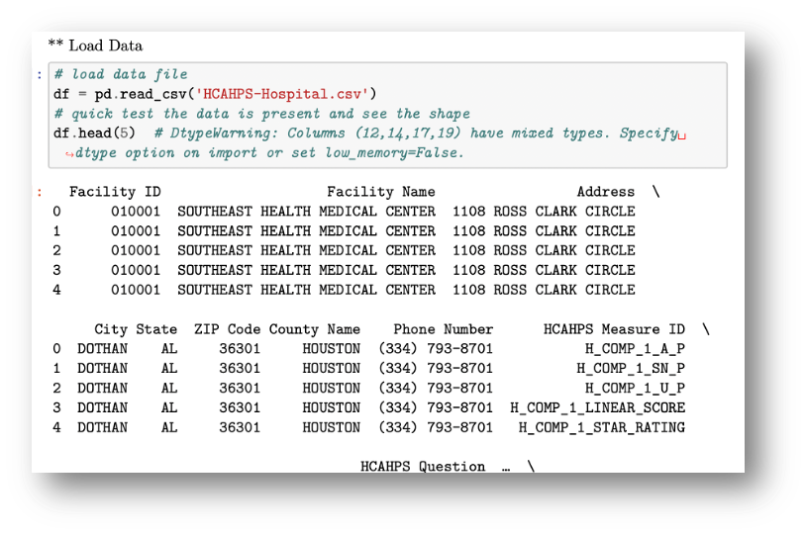
B – Data collection (cont.) Load the Data
This survey dataset captured all three measures compared in this analysis for over 4,000 clinics providing from over 450,000 rows of data.
After the dataset was identified, it was downloaded from the Centers for Medicare & Medicaid Services (CMS, 2022) and then loaded into a data frame (Figure 1).
Figure 1 - Load Dataset from *.csv File

Slide 6
Once the data is loaded into a data frame, unnecessary columns were dropped and/or renamed for easier processing.
C – Data Extraction and Preparation

Slide 7
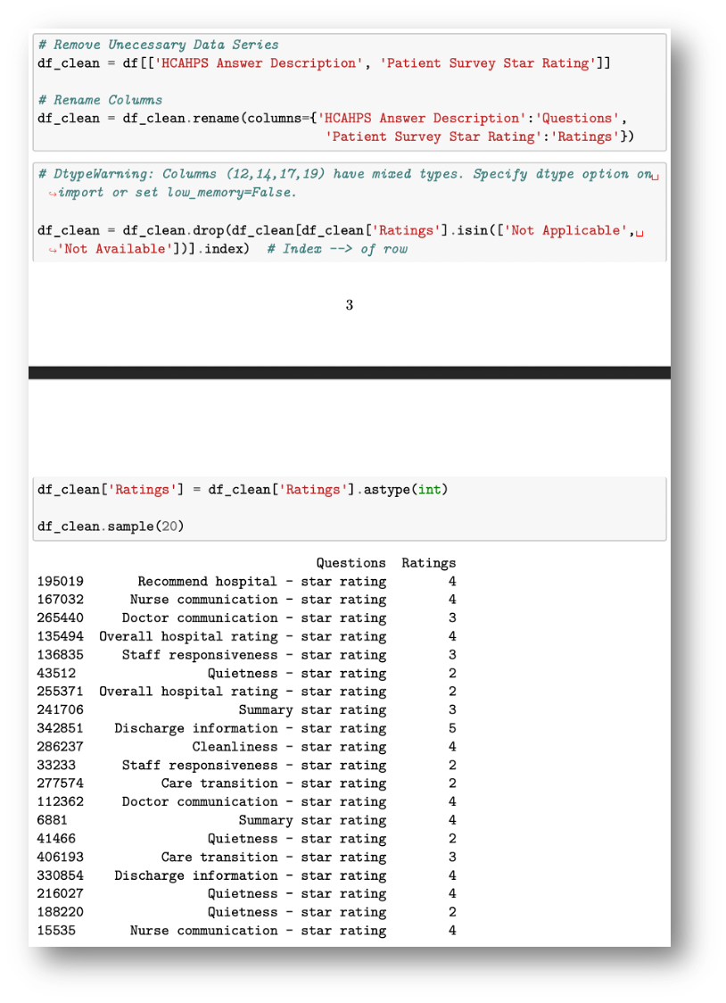
c – Data Extraction and Preparation (cont.)
Some columns had “Not applicable” and “not available” which caused errors. These non-numerical data points were removed, and the data series was converted to an integer data type. While processing the data may not appear as intuitive as using a graphical user interface, this approach is very efficient as data scales. (Figure 2)
Figure 2 - Remove Unnecessary Columns, Clean up Mixed Data Types and Rename Columns

Slide 8
Exploratory data analysis was performed on the refined data frame.
D – Analysis

Slide 9
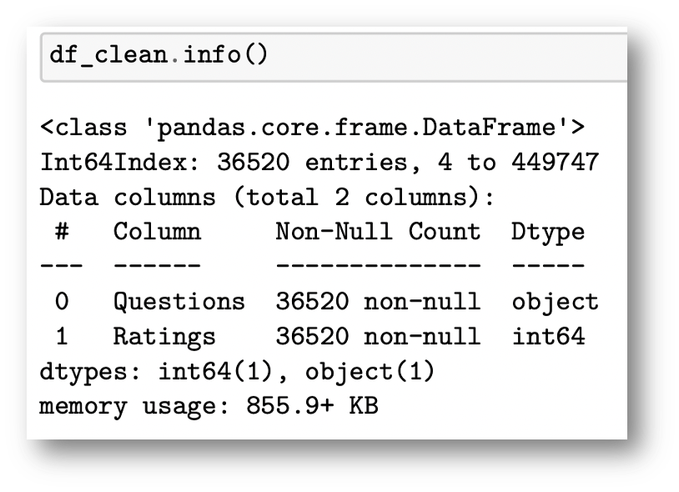
d – Analysis (cont.)
Info() method to verify column names, null-value counts, and data types. (Figure 3)
Fi Figure 3 - Pandas .info() Method

Slide 10
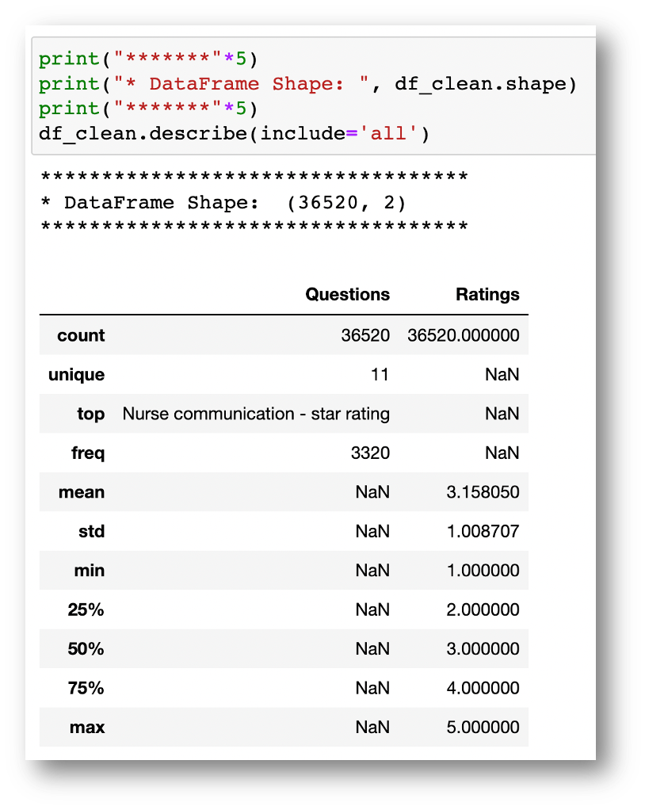
d – Analysis (cont.)
Shape and describe() methods were used to understand the data frame’s shape, count, unique categorical entries, most frequent with count, mean, standard deviation, minimal, maximum and quantiles 25%, 50% and 75% of the rating values. (Figure 4)
Figure 4 - Pandas .describe() Method

Slide 11
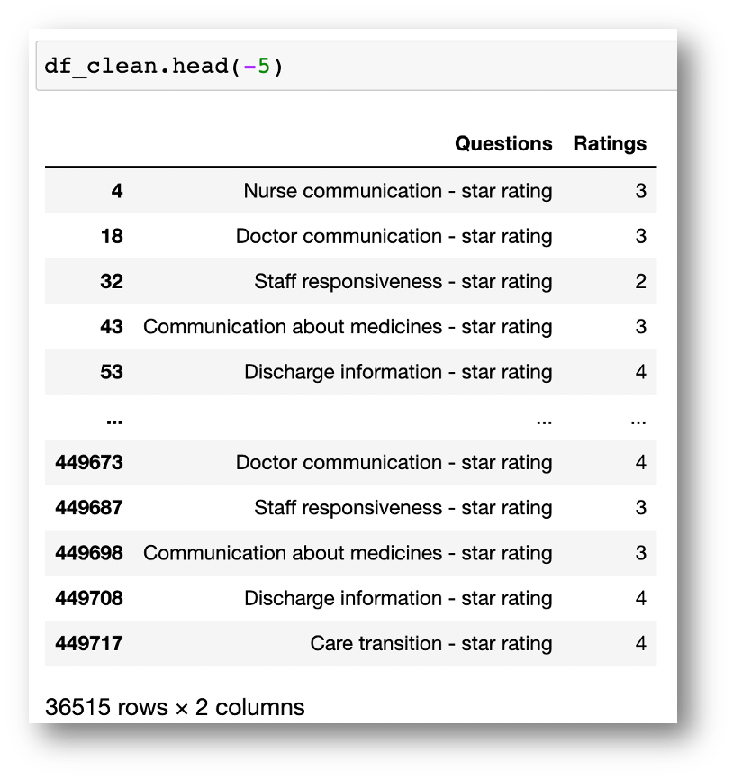
d – Analysis (cont.)
Head() method was used to understand the layout of the data frame. An attribute of -5 showed the first and last 5 rows. (Figure 5)
Figure 5 - Pandas head() Method

Slide 12
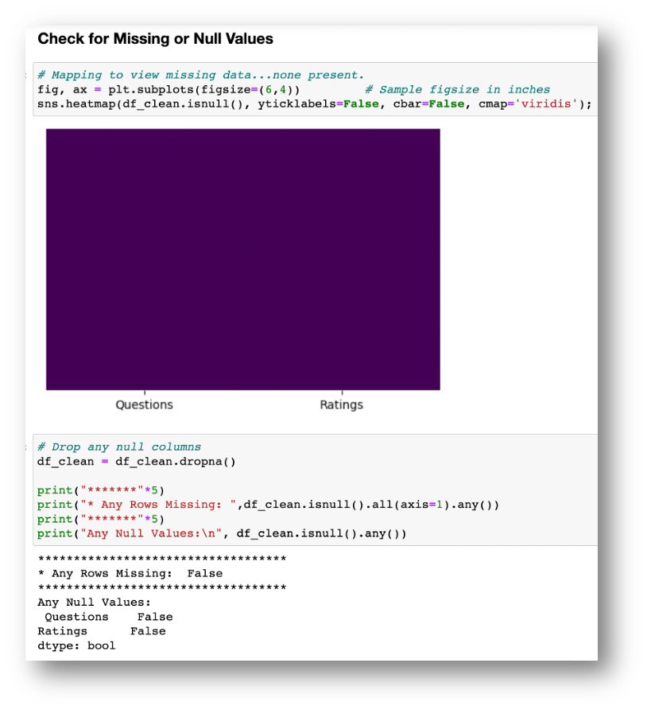
d – Analysis (cont.)
A Seaborn heatmap was used to show any null values graphically. Additionally, Pandas dropna() and .isnull() methods were used to help verify. (Figure 6)
Figure 6 - Check for Missing or Null Values

Slide 13
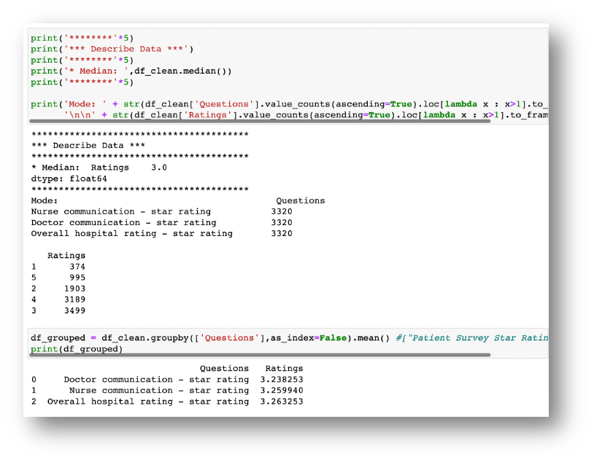
d – Analysis (cont.)
Questions and ratings were counted. Then the questions were grouped using the .groupby() method to show each question’s mean rating value. (Figure 7)
Figure 7 - Group Question and Rating Data to Aggregate

Slide 14
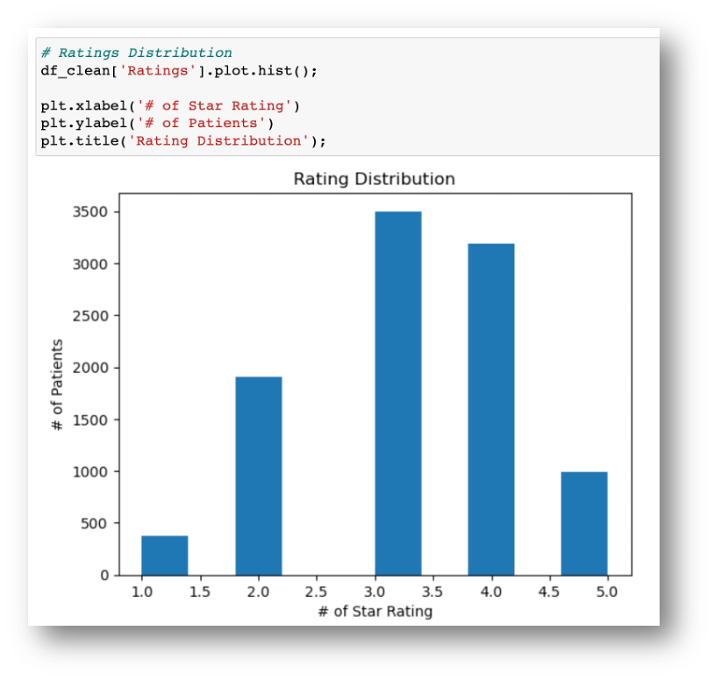
d – Analysis (cont.)
Ratings histogram was created, providing visual distribution. (Figure 8)
Figure 8 - Ratings Distribution

Slide 15
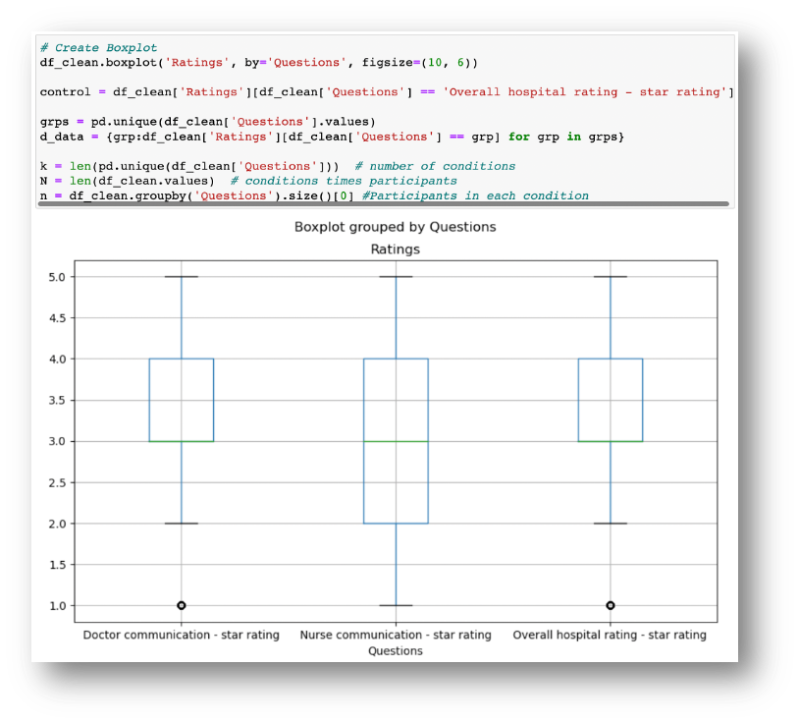
d – Analysis (cont.)
Boxplots were created to display the minimum, first quartile, median, third quartile, and maximum values of each grouped question. (Figure 9)
Figure 9 - Boxplot of Questions

Slide 16
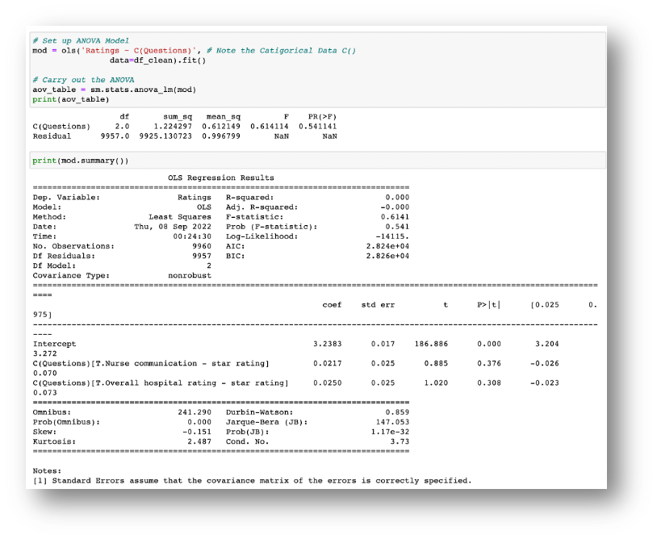
d – Analysis (cont.)
One-way Analysis of Variance (ANOVA) was calculated. See Figure 10. According to Norman, 2010 “Parametric statistics can be used with Likert data, with small sample sizes, with unequal variances, and with non-normal distributions, with no fear of ‘‘coming to the wrong conclusion’’. These findings are consistent with empirical literature dating back nearly 80 years.” One disadvantage of choosing ANOVA to analyze Likert scale data seemed to be within the limitation of the survey interpretations themselves. The questions to be rated are still able to be interpreted by the individual which may differ when compared to the research objectives.
Figure 10 - One-Way ANOVA

Slide 17
Review of Hypothesis – is communication from a doctor more statistically significant to a patient’s overall hospital rating than a nurse? Null Hypothesis – doctor communication does not have a more statistically significant impact on the overall hospital rating when compared to a nurse. Alternate Hypothesis – doctor communication has a more statistically significant impact on overall hospital rating when compared to a nurse.
E – Data Summary and Implications

Slide 18
E – Data Summary and Implications (cont.)
ANOVA, was performed on the data set to ascertain if “…a significant difference among the groups tested” (Dr. Sewell, n.d.)
ANOVA – uses an F-statistic to measure mean equality of a group and a p-value to measure probability under the assumed hypotheses.
F-statistic: 0.6141, e.g. statistically more significant than random chance
P-value 0.541. When P > 0.05 → the null hypotheses being true.
Null Hypothesis – doctor communication does not have a more statistically significant impact on the overall hospital rating when compared to a nurse.
Analysis shows a tight range between doctor, nurse and overall ratings. Both independent variables seem to be important to a hospitals overall rating.
Figure 10 - One-Way ANOVA

Slide 19
E – Data Summary and Implications (cont.)
Recommendations:
Since a patients experience with their doctor and nurse are both important to the hospital’s overall rating, continued training and improved provider/patient relations should be strived for.
More specific questions could be added to the patient survey to dig deeper into understanding what key behaviors could be championed to improve.
Limitations:
A limitation within the current survey points to how providers communicate, but this really isn’t the whole story. Trying to understand why a patient provided a certain rating will help illuminate where focus is needed to produce desired results.

Slide 20
Help Using Markdown: Https://Www.Markdownguide.Org/Basic-syntax Mactex: Https://Tug.Org/Mactex/Mactex-download.Html Matplotlib Help: Https://Matplotlib.Org/2.1.2/Api/_As_gen/Matplotlib.Pyplot.Plot.Html Numpy Help: Https://Numpy.Org/Doc/Stable/ Pandas Help: Https://Pandas.Pydata.Org/Docs/User_guide/Index.Html#user-guide Python Help: Https://Docs.Python.Org/3.9/Library/Index.Html Scipy.Stats Help: Https://Docs.Scipy.Org/Doc/Scipy/Reference/Tutorial/Stats.Html Seaborn: Https://Seaborn.Pydata.Org/Api.Html References: See The References Section.
F - Sources

Slide 21
Sewell, W. (N.D.). Lecture: D207 T2 – Welcome To D207 Eda Webinar. Western Governors University. Found Here: Https://Wgu.Hosted.Panopto.Com/Panopto/Pages/Viewer.Aspx?Id=fcf752f1-6ff7-4286-9100-ad1f016a98d6 Patient Survey – Hospital Consumer Assessment Of Healthcare Providers And Systems (HCAHPS). (2022). Centers For Medicare & Medicaid Services (CMS). Found Here: Https://Data.Cms.Gov/Provider-data/Dataset/Dgck-syfz Norman G. Likert Scales, Levels Of Measurement And The "Laws" Of Statistics. Adv Health Sci Educ Theory Pract. 2010 Dec;15(5):625-32. Doi: 10.1007/S10459-010-9222-y. Epub 2010 Feb 10. Pmid: 20146096. Schmocker R.K., Holden S.E., Vang X, Leverson G.E., Et. Al., Association Of Patient-reported Readiness For Discharge And Hospital Consumer Assessment Of Health Care Providers And Systems Patient Satisfaction Scores: A Retrospective Analysis. J Am Coll Surg. 2015 Dec;221(6):1073-82.E1-3. Doi: 10.1016/J.Jamcollsurg.2015.09.009. Epub 2015 Sep 25. Pmid: 26474513; Pmcid: Pmc4662900.
References

